Slide 1
Dark Web and Privacy Analytics Research: Hands-on Training and Planning
Presenters: Reza, Amy, Ben A, Zara, Weifeng
Thanks to Ning, James, and Justin
Artificial Intelligence Lab, University of Arizona
September 4, 2020

Slide 2
Training Overview
Introduction
Importance of Data Collection
Preparation
Recommended Environment for Security and Privacy Research
Learning Modules
Module 1: Dark Web Analytics
Dark Web Collection
Dark Web Crawling, Parsing, and Storage Demo
Hacker Asset Portal Demo
Module 2: Privacy Analytics
Personally Identifiable Information (PII) Collection
Data Breach Monitoring System
Surface Web Collection (People Search Engine)
Deep Web Collection (Social Media)
Entity Resolution Review
Privacy Risk Assessment
PII Portal Design and Planning

Slide 3
Introduction
This tutorial has four major goals:
Introduce two major AI Lab projects: Dark Web Analytics and Privacy Analytics
Introduce relevant data sources/platforms for each project
Deliver a hands-on training on how to collect data for each project
Provide planning and identify team members’ responsibilities
Dark Web Analytics is part of the NSF SaTC Project.
Privacy Analytics (PII Project) is the current lab’s focus.
Both projects rely on comprehensive data collection using efficient tools.
We next describe the importance of data collection and provide a recommended software environment for this purpose.

Slide 4
Introduction – Importance of Data Collection
AI Lab research is data and information-centric.
Our research often relies on building machine learning/AI models.
These models learn from examples.
Without accessing the data, building a learning model is almost impossible.
Almost all past cybersecurity publications coming from the AI lab, has their own collected data.
Our lab collects the most comprehensive, up-to-date, academic datasets in security and privacy research.

Slide 5
Preparation – Recommended Environment for Security and Privacy Research
A first step to data collection and subsequent AI lab research is to correctly setting up the research environment.
Common tools used in cybersecurity and privacy research environment at the AI Lab are categorized into 3 areas:
Infrastructure
Programming Tools (mostly Python, Rarely Java)
Data Analytics-specific Packages
The list provided in this set of slides is not meant to be an exhaustive list of tools. Rather, it includes the essential tools that have been used frequently in various projects.

Slide 6
Preparation – Recommended Environment for Security and Privacy Research: Infrastructure
Browser
Tor Browser: An interface to connect dark web.
FireFox Browser (Optional)
Operation System
Windows
Linux: Ubuntu (Recommended), etc.
Database
MySQL Workbench: A visual interface for MySQL database.
MongoDB
File Viewer
Notepad++

Slide 7
Preparation – Recommended Environment for Security and Privacy Research: Programming Tools
Python
Version: 2.7 or 3.x
Integrated Development Environment (IDE)
Sublime Text 3, Atom, Redeo, PyCharm, etc.
Jupyter Notebook: A web application to execute code and debugging
Libraries
Database Connection: mysql-connector, pymongo
Data Collection: Scrapy, Selenium, Beautiful Soup
Environment Management
Anaconda: Manage multiple versions of Python programs on your PC
pip: Tool to easily install and update needed libraries.

Slide 8
Preparation – Recommended Environment for Security and Privacy Research: Data Analytics-specific Packages
Data analytics includes preprocessing, model construction, and visualization.
Preprocessing
NumPy, Pandas, Regular Expression
Model Construction:
Scikit-learn: A package to easily implement classic machine learning algorithms.
TensorFlow: A powerful deep learning library supported by Google.
Keras: Assist users to quickly build neural network by TensorFlow
PyTorch: Facebook’s deep learning framework
Visualization:
Tableu: A flexible and easy-to-use data visualization tool.
Python and R libraries: Matplotlib
NetworkX: A powerful tool for creation, manipulation, and study of complex networks

Slide 9
Learning Modules
Based on the current security and privacy analytics research in the AI Lab, this training session encompasses two learning modules.
Module 1: Dark Web Analytics
Module 2: Privacy Analytics
Module 1 covers Dark Web, live demo of Dark Web collection, and Hacker Asset Portal.
Module 2 covers Personally Identifiable Information (PII) Collection, PII analytics, and PII Portal.
Members of the CICI project can benefit from the materials. The infrastructure and principles are common across all projects.

Slide 10
Module 1 (M1): Dark Web Analytics
Dark Web Collection
Live Demo: Dark Web Crawling, Parsing, and Storage
Hacker Asset Portal (HAP) Demo

Slide 11
M1 – Dark Web Analytics: Agenda & Learning Goals
We introduce dark web hacker community platforms.
Dark net markets (DNMs), hacker forums, carding shops
Learning goal: You will know what data is available in the dark web.
We demo data collection for two platforms: DNMs and hacking forums
Collecting carding shops is similar to DNM but more straightforward.
Learning goal: You will learn how to write crawlers and parsers.
We demo Hacker Asset Portal to show how the collected data is leveraged to build an end-to-end cybersecurity system.
Learning goal: You will see an example of using the collected data for analytics and disseminating new insights from analytics.

Slide 12
M1 – Dark Web Analytics: Overview
Dark Web is a large conglomerate of platforms that facilitate illegal transactions among hackers/cybercriminals.
Dark web comprises three major platforms:
Dark Net Marketplaces
Hacker Forums
Carding Shops
Within each platform, we start with a brief overview of available information and then we give a tutorial and live demo for data collection.
We conduct a live demo for hacker forums and DNMs.
Collection of carding shops is similar to, and less complicated than DNMs.

Slide 13
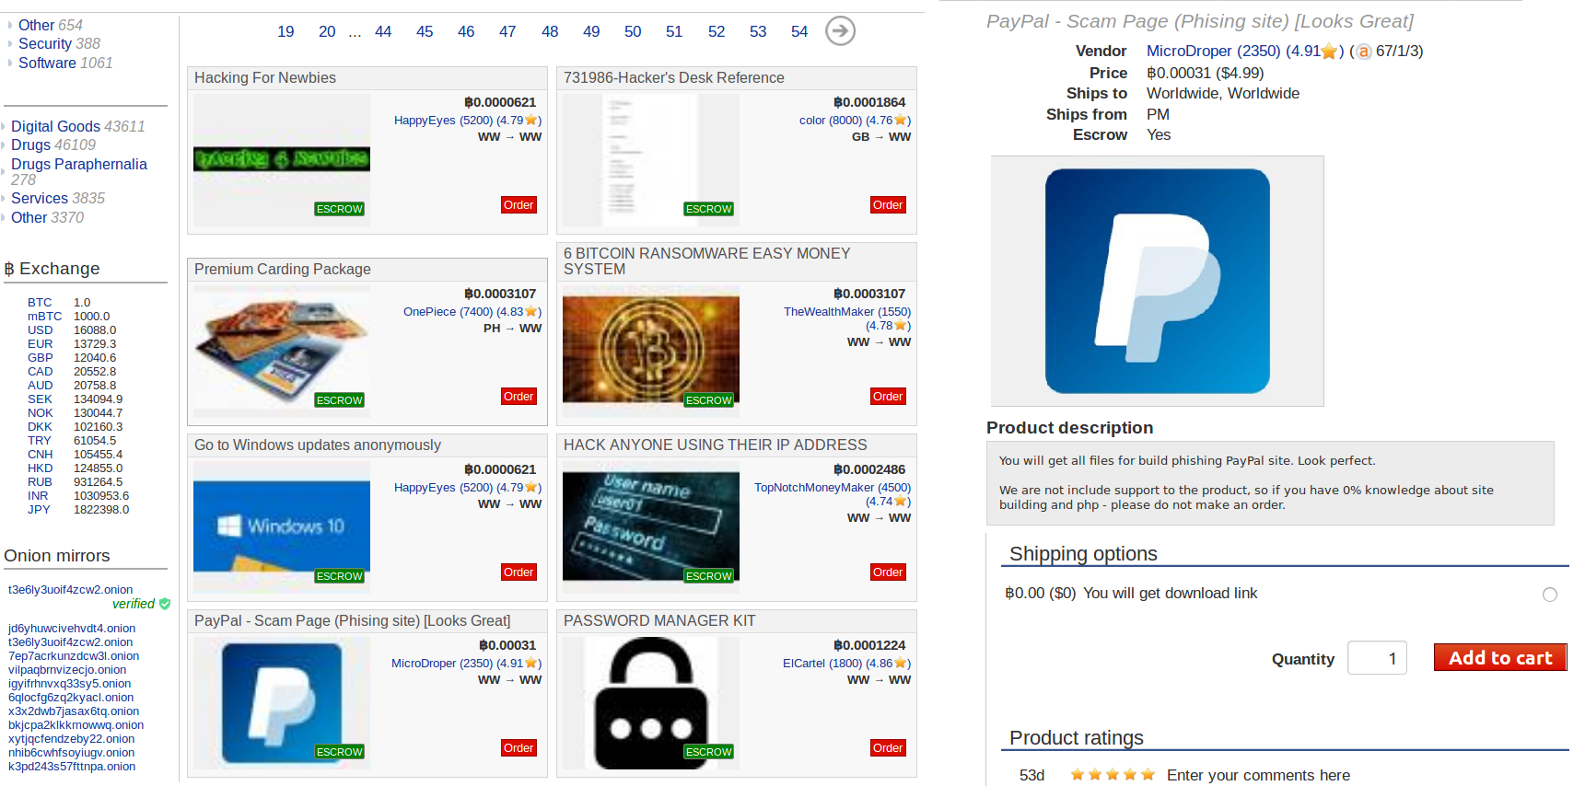
M1 – Dark Net Marketplaces (DNMs)
Seller
Price
Product Description
Product Reviews
Figure 1. Snapshot of Dream Market and an Example of a Phishing Product for PayPal.
Recommended collection tool: Selenium. We will see this in action in the live demo.

Slide 14
M1 – Dark Net Marketplaces: Available Information
Type | Category | Attributes
Listing | Product Information | Name, Category*, Description, Shipping options*, Keywords*, Seller, Views
 | Sales Information | Price/Bids*, Payment*, Sold since*, Ends in*, Quantity sold*, Quantity left*, Refund Policy*
 | Location Information | Origin country*, Available destination country*
 | Feedback | Buyer*, Date*/Time*, Rating*, Comment*
Seller | Basic Information | Name, ID, Member since*, contracts*, contact, PGP*
 | Quality Information | Certificate*/Badge*/Level* (from the marketplaces)
 | Feedback | Buyer*, Ratings*, Comments*, Statistics*
Table 1 shows the available attributes in DNMs:
Product listings: four categories, 20 attributes.
Sellers: three categories, 14 attributes.
While these attributes are comprehensive, not all of them will appear in every marketplace.
Table 1. Relevant Dark Net Marketplace Attributes for Collection
*May not be available in all marketplaces

Slide 15
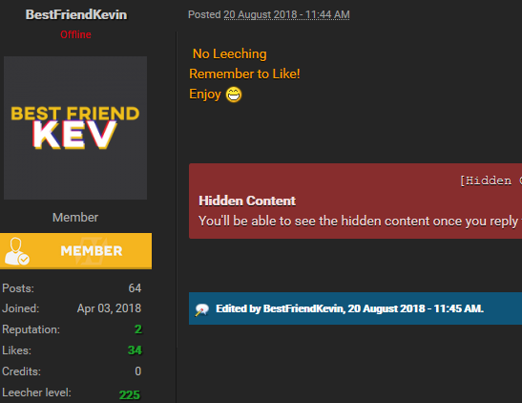
M1 – Hacker Forums
Threads in Subforum
Date
User Information
(Joined date, # of posts, etc.)
Post Content
Figure 2. Snapshot of a subforum in a large hacker forum
Recommended collection tool: Scrapy. We will see this in action in the live demo.

Slide 16
M1 – Hacker Forums: Available Information
Type | Attributes | Description
Posts | postID | Unique numeric identifier of a forum post
 | threadID | Unique numeric identifier of the thread a post is made in
 | authorID | Unique numeric identifier of the author of a forum post
 | URL | URL which the forum post can be found in
 | Subforum | Title of the subforum the post is found in
 | threadTitle | Name of the thread the post was made in
 | authorName | Name of the author who made the post
 | postdate | Calendar date that the post was made
 | postSequence | Sequence in which the post was made in a thread
 | Flatcontent | Raw textual content of the forum posting
 | hasAttachment? | Boolean indicating whether a post has an attachment
Threads | threadID | Unique numeric identifier of a thread
 | threadTitle | Title of a thread
 | numOfPosts | How many posts the thread has
 | numOfViews | Number of views a thread has
Code | codeID | Unique identifier for each piece of source code
 | postID | Unique numeric identifier of the forum post the code is in
 | threadID | Unique numeric identifier of the thread the code is in
 | code | Raw source code found within a forum post
Type | Attributes | Description
Authors | authorID | Unique numeric identifier of an author
 | authorName | Name of an author
 | reputationScore* | An authors reputation
 | Location* | An authors location
 | Occupation* | An authors occupation
 | dateJoined | Date an author joined the forum
 | numberOfPosts | Number of posts an author has made
 | Description* | An authors description
 | Sex* | An authors sex
 | Birthday* | An authors birthday
 | lastActive | Date an author was last active
 | forumRole | An authors forum role
Subforums | subforumID | Unique numeric identifier of a subforum
 | subforumName | Name of a subforum
 | numOfThreads | Number of threads in a subforum
 | numOfPosts | Number of posts in a subforum
Table 3. Author and Subforum Attributes to be collected from forums
*Not available in all forums
Table 2. Post, Thread, and Code Attributes to be collected from forums

Slide 17
M1 – Carding Shops
Search Functionality
Bank Identification Number
Credit Card Type
Expiration Date
Bank Name
Figure 3. An Example of a Carding Shop Featuring Stolen Credit Cards

Slide 18
M1 – Carding Shops: Available Information
Table 4 summarizes the available data types in carding shops.
Type | Attribute | Description
Card | BIN | Bank Identification Number, the first 6 digits of the card number
 | Card type | Personal/business card; visa/master/amex/discover; classic/standard/platinum/gold/signature
 | Expires | The expiration date of the card
 | Issuer | The financial institute that issued the card
Source | Base code | An arbitrary name assigned to a unique batch of cards stolen from a merchant(s) breach
 | Location | Location where the card information got skimmed, including country, state, city
 | Zip Code | Zip code corresponding to the location
Price | Price | Selling price of the CC/dump
Table 4. Carding Shop Data Attributes

Slide 19
M1 – Carding Shops: Available Information (cont’d)
Table 5 describes the difference of CC (Fullz) and Dumps.
CC can be used in card-not-present transactions, while dump is used to forge fake cards in card-present transactions.
 | CC/CVV | Dump
Description | A package of data about the cardholder | Information electronically copied from the magnetic strip on the back of credit and debit cards
Usage | Card not present transactions (online/by phone) | Card present transactions (in-store/ATM)
Contained Information | Name, card number, CVV, expire date, address, phone, SSN, and other personal identifying info | Track1: name, card number; Track2: expire date, service code, discretionary data
Example | Card Number: 4266841209090735 Expire Date: 01/2012 CVV: 131 Cardholder Name: Walter Leger Address: 4701 Rue Laurent City: Metairie – LA – 70002 | B5177220046948089^FARAH TUKAN ^1504101100000000000000149 5177220046948089=150410110000149
Table 5. Comparison of CC and dumps

Slide 20
M1 – Live Demo: Dark Web Crawling, Parsing, and Storage
In this live demo you will learn:
How to write python code to use Selenium and Scrapy for automated browsing.
How to write a systematic code that traverses the URLs/Onion links.
How to extract information from the stored HTML pages with Beautiful Soup.
How to insert data into a predefined structured format in the database with Python and MySQL.
Feel free to contact us for accessing a copy of the code so that you can modify it for your own data collection.

Slide 21
M1 – Live Demo: Crawler
Guidelines for Writing Crawlers
Check request headers and their value.
Identify the request type (i.e., GET, POST).
Maintain the connection with the server using Cookies or Sessions.
Find out how to redirect crawler to next page (e.g., click via Selenium, change page number in the web domain, or send the POST request with updated page value.)
Connect to the website using your proxy (e.g., Tor).
Adjust visiting frequency of the crawler in a way that it mimics human’s behavior (set random interval between requests).

Slide 22
M1 – Live Demo: Crawler (cont’d)
Anti Crawling Measures
Most platforms apply anti-crawling measures. We provide a general guide on how to circumvent them:
Anti-crawling measure: CloudFlare verifies the HTTP request comes from a legitimate IP address rather than a public known proxy, such as Tor.
Counter measure: using a proxy such as Digital Ocean.
Anti-crawling measure: CloudFlare detects possible DDoS signs.
Counter measure: putting random waits in your program before sending your requests.
Time.sleep (2) \\ 2-second wait in Python
Anti-crawling measure: CAPTCHA is used to verify the user interacting with the website is human.
Counter measure: Try to store cookies in your browser.

Slide 23
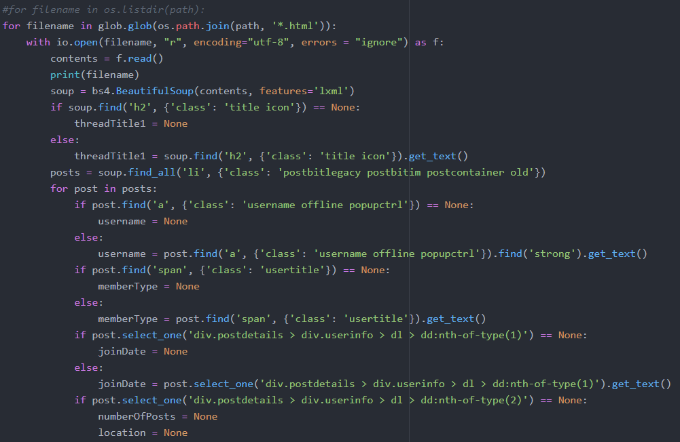
M1 – Live Demo: Parser
Parsing Collected Data
Parsing: Extracting useful information from raw HTML files.
Using Python, we can iterate through HTML files and parse.
BeautifulSoup can be used to find specified XPaths and extract information.
Information is saved to Python variables, which are then used to store the data into a MySQL database.
Figure 4. Code of Parser

Slide 24
M1 – Live Demo: Storage
Storing Collected Data
Python MySQL Connector is used to store the data.
The database and table must be created first in MySQL before data can be inserted in Python. The column names must match.
It is important to include integrity checks within your database to delete duplicate data before it is inserted.
Parsers and Crawlers can be part of the same Python script, which can be placed into a batch script and Windows Scheduler for automatic running at set intervals.
Figure 5. Code of Storing data

Slide 25
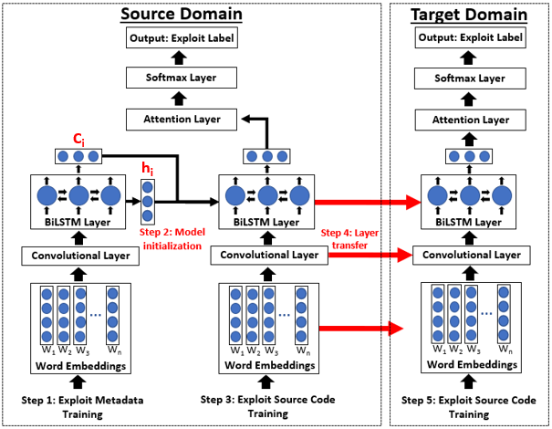
M1: Hacker Asset Portal (HAP) Demo
DTL-EL
Figure 6. Proposed HAP Design
Notes:
Text and Data mining
Traditional CTI analysis (Summary statistics, malware analysis)

Slide 26
M1: HAP - Features
The proposed portal has five major components:
Core Technologies: Built upon the Python-based Streamlit framework
Data Collection: Incremental collection of hacker community and vulnerability assessment data
System Analytics: Integration of recent AI lab analytics (GCN, DSSM, DTL-EL) and conventional CTI analytics (VirusTotal, Hybrid Analysis)
Core Functionalities: Search, sort, browse, custom user profiles
Visualization and Reporting: dynamic visualizations, API for data access
Table 6 summarizes the proposed and current system designs.
The subsequent slides further detail each component of the proposed system.
Notes:
Crawlers are incremental and crawl, parse, and upload data to a MySQL database in one step.
The website is built upon a Django back-end, which is specially designed for big data driven applications.
Deep learning algorithms are applied to crawled data for interesting and novel feature additions.
Tableau visualizations are dynamic and will update automatically when the MySQL database gets new data.
New core functionalities allow for easy user customization.

Slide 27
M1: HAP Design
Function | Feature | Old Design | New Design
Core Technologies | Crawling / Parsing | Offline Explorer | Scrapy, BeautifulSoup
 | Website Backend | PHP, HTML5, CSS3 | Streamlit
Data Collection | Hacker Community | Hacker forums, carding shops, DNMs | Traditional hacker forums, 0day, public repos
 | Vuln. Assessment | - | Nessus and NVD
System Analytics | CTI Analytics | Summary Statistics, Malware Analysis | Static Code Analysis, VirusTotal, Hybrid Analysis
 | Data Mining/Text Analytics | LDA, SVM | GCN, DTL-EL, EVA-DSSM
Core Functionalities | Browse | Browse based on asset category | Browse based on asset category
 | Search | Character by character search on metadata; single category only; metadata only | Fuzzy search and character by character search on metadata and raw content; within and across categories
 | Download | Text file only | Text, JSON, CSV
 | User Profiles | - | -
Visualization and Reporting | Visualization | Static Dashboards | Dynamic Dashboards
 | Reporting | VirusTotal Reports | HAP API, MITRE ATT&CK API, VirusTotal Reports
Table 6. Summary of Changes Between Original and Proposed HAP

Slide 28
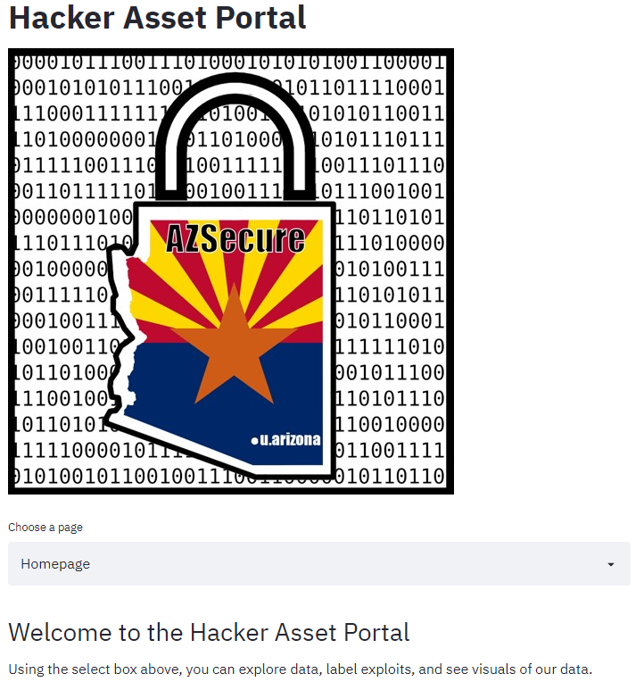
M1: Hacker Asset Portal Demo
The HAP aims to offer up-to-date data, analytics, and visualizations for the cybersecurity research community.
We now demonstrate the current state of the HAP, and the python code behind it.
Selected content includes sample hacker data, exploit labeler, time-series analysis graphs, and prominent hackers.
Key takeaways from the HAP include data presentation, visualization strategies, and holistic approaches to building portals for your research.
Figure 7. Hacker Asset Portal Homepage

Slide 29
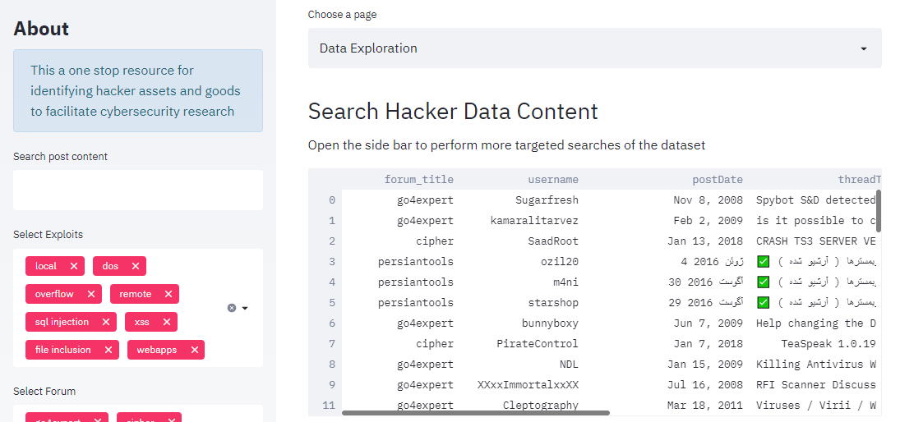
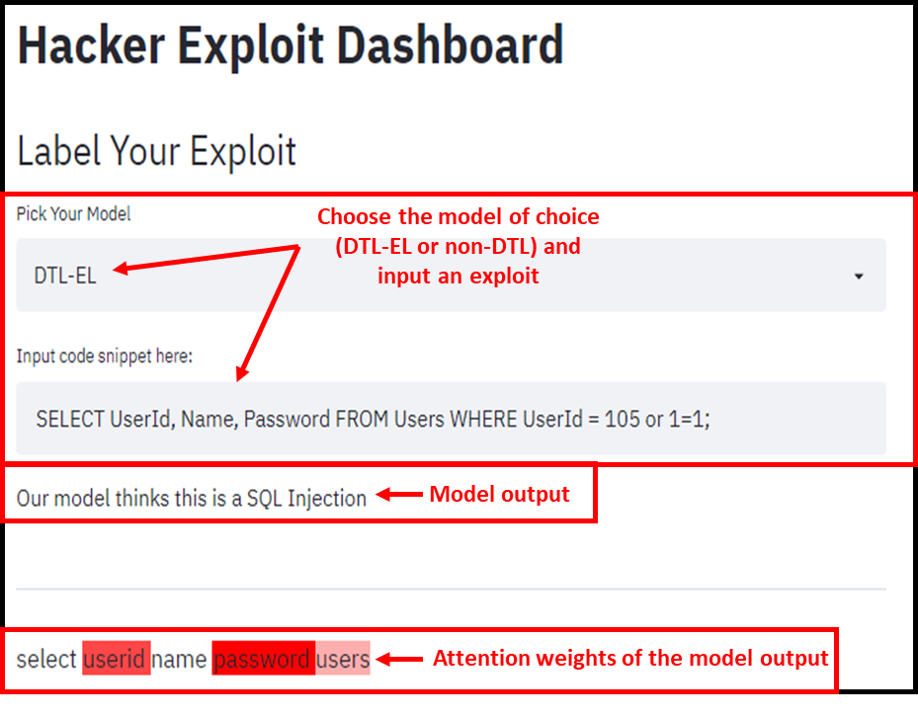
M1: Hacker Asset Portal Demo - Features
Look through data
Filter Data
Figure 8. Hacker Asset Portal Sample Data
Figure 9. Hacker Asset Portal DTL-EL Implementation
Users can look through labeled hacker exploits and filter by post content, exploit type, and forum.
Exploits can be input into the model allowing for immediate label.

Slide 30
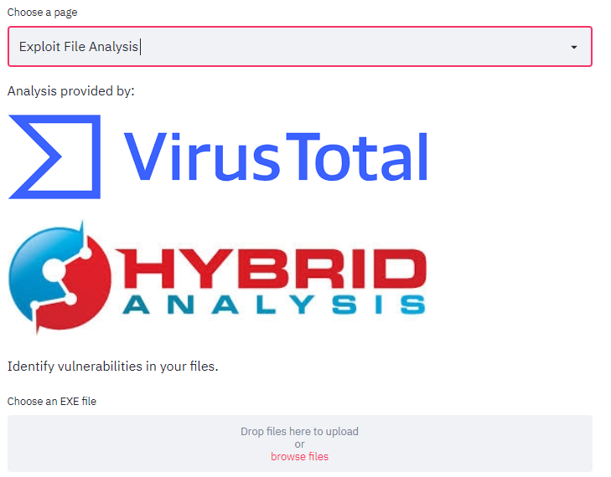
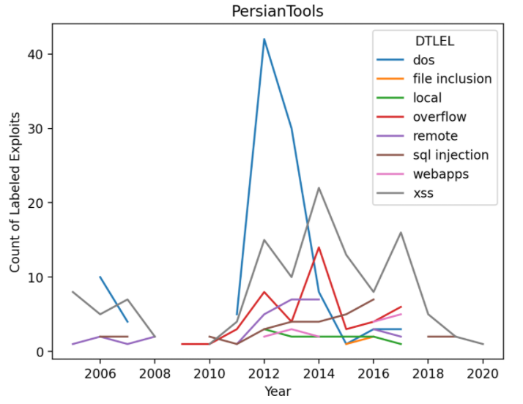
M1: Hacker Asset Portal Demo - Features
Figure 10. Hacker Asset Portal File Analysis
Figure 11. Hacker Asset Portal Visualizations
Suspected malware can be uploaded to be analyzed by the VirusTotal and HybridAnalysis APIs concurrently.
Time series analysis charts of labels in each forum are created automatically upon collection and labeling of data.

Slide 31
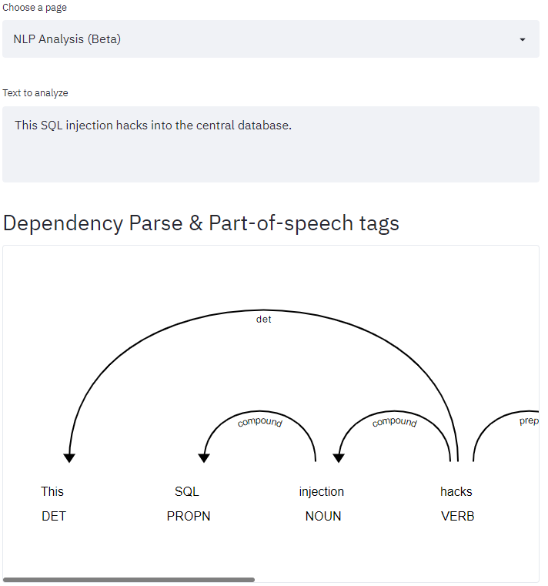
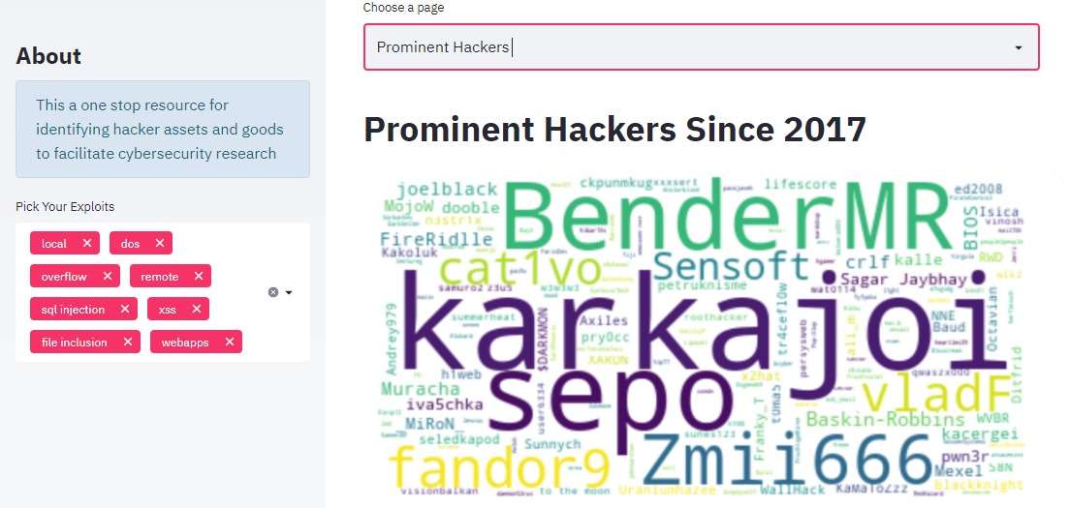
M1: Hacker Asset Portal Demo - Features
Text to be input
Figure 12. Hacker Asset Portal Key Hackers
Figure 13. Hacker Asset Portal PoS Tagging (Beta)
Key hackers are identified through word clouds and tables and can be divided based on exploit label.
NLP analysis can be performed on hacker text to gain more information about the way it is formulated.

Slide 32
Module 2 (M2): Privacy Analytics
Personally Identifiable Information (PII) Collection
Data Breach Monitoring System
Surface Web Collection (People Search Engine)
Deep Web Collection (Social Media)
Entity Resolution Review
Privacy Risk Assessment
PII Portal Design

Slide 33
M2 – Privacy Analytics: Agenda & Learning Goals
We introduce our data breach monitoring system to automatically detect newly breached data.
Learning Goal: You will know how to leverage RSS feeds to monitor data breach incidents from news and message boards.
We introduce surface web and deep web platforms for extending PII collection from the dark web.
Surface web: people search engines; deep web: social media
Learning Goal: You will know what data is available in the surface web and deep web and will learn how to collect data from them through crawlers or APIs.
We review Entity Resolution (ER) for linking PII from the dark web to the surface web and deep web.
Learning Goal: You will get familiar with ER, its methods, and its necessity for PII analytics.
We propose our PII Portal design and planning for building an end-to-end privacy assistant tool to increase users' awareness of privacy risk.

Slide 34
M2 – Privacy Analytics: Overview
Along with the proliferation of the internet comes immense privacy concerns about users’ Personally Identifiable Information (PII).
To inform users about their privacy risk, comprehensive privacy risk assessment is needed.
→ Requires matching exposed PII on both the dark web and surface web.
However, due to the incompleteness and inaccuracy of PII records, linking the exposed PII to users is a non-trivial task.
Entity Resolution (ER) techniques can be used to facilitate this task,
In sum, we need three components: comprehensive PII collection, ER, and privacy risk assessment.
We start with the PII collection and then proceed to the next two components.

Slide 35
M2 – PII Collection: Data Breach Monitoring System
Data Breach Monitoring System aims to consistently monitor and investigate emerging breaches.
We leverage RSS feeds to collect the latest data breach news from security message and news boards on the surface web.
RSS is a standardized XML format used to access content from websites, such as news headlines, blog posts, and other periodic content.
RSS feeds have a unique URI which users can access programmatically through RSS reader, script, or program
Next, we illustrate our proposed data breach monitoring system.

Slide 36
M2 – PII Collection: Data Breach Monitoring System
Task Scheduler: Every 24 hours
4
Data
Python Script
Daily News Update Channel
1
Date
Relevance
Existing
Post
5
Data Breach News Sources:
RSS Feeds, Reddit
3
Source
Headline
Date
Link
2
Shelve
Request
Slack
CSV file
Figure 14. Data Breach Monitoring System
AI Lab Server

Slide 37
M2 – PII Collection: Data Breach Monitoring System
Step 1: Identify news/blog sources and click the link to subscribe to their RSS feeds
Step 2: Select the URL for programmatically accessing the feed
In your python script, make an HTTP GET request to the URL provided by the source
Alternatively, utilize feedparser to handle HTTP requests
Figure 15. Subscribe to RSS Feeds
Figure 16. Code of accessing the feed

Slide 38
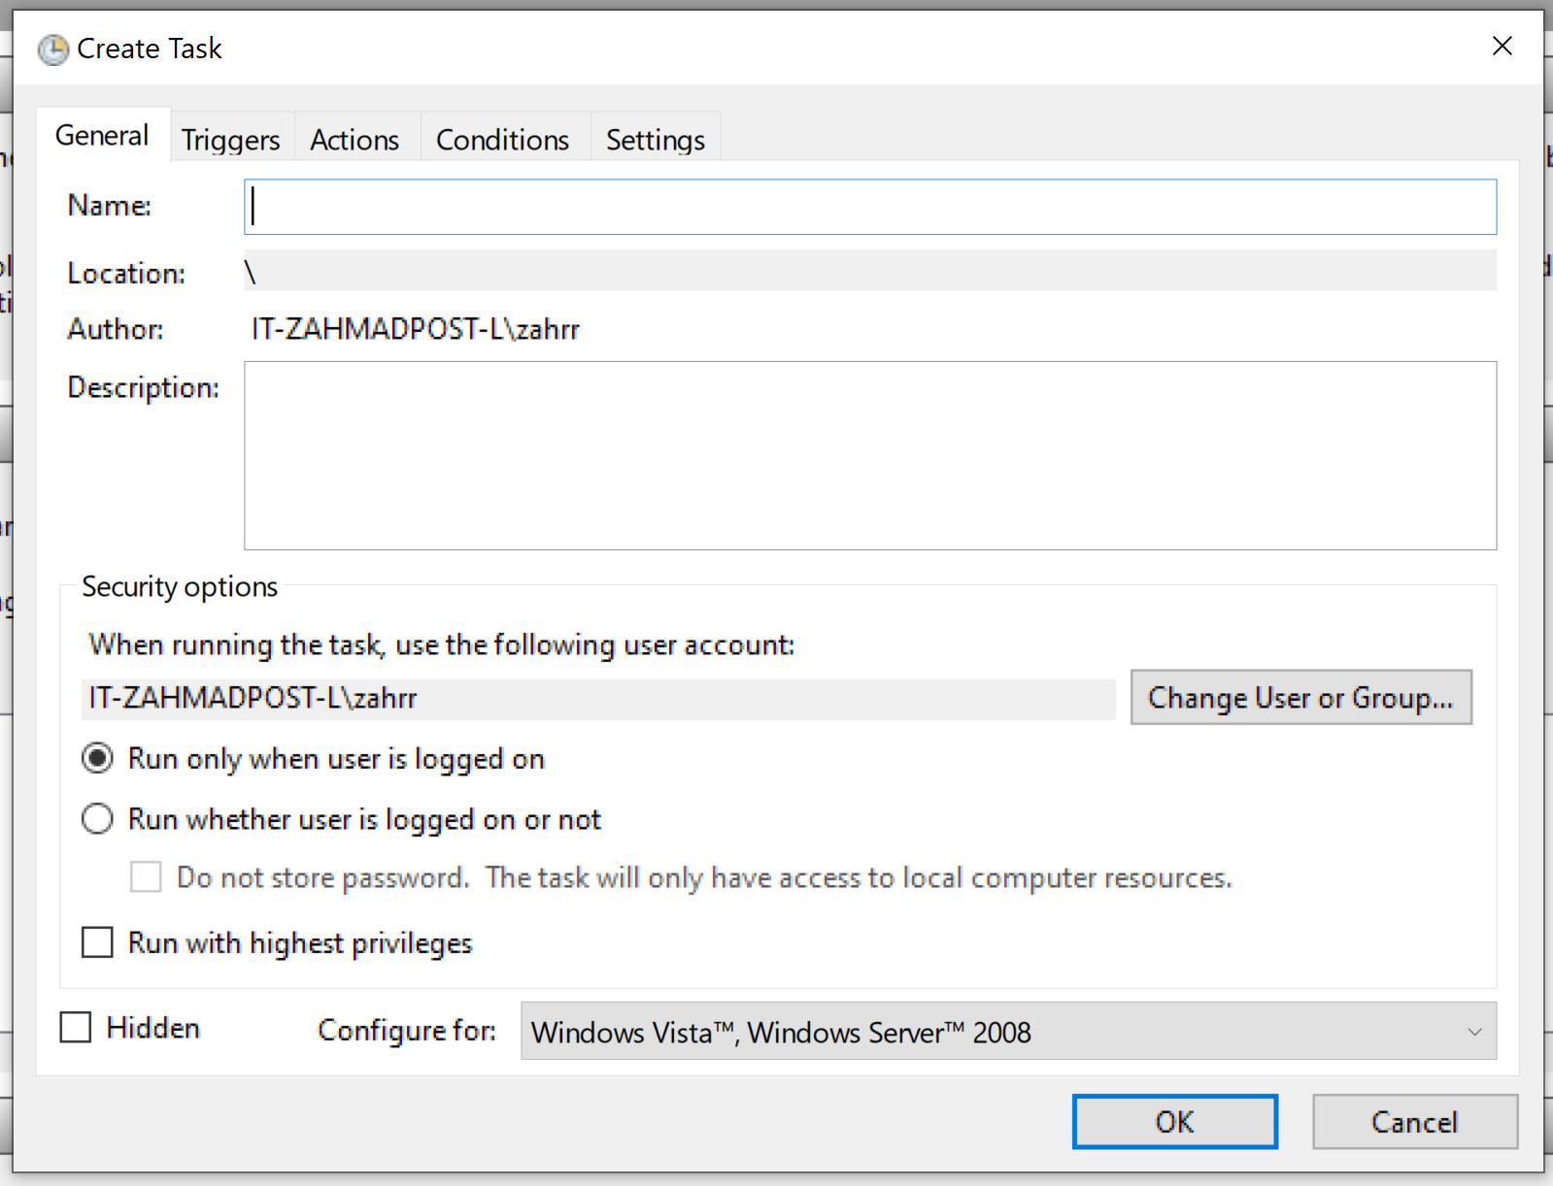
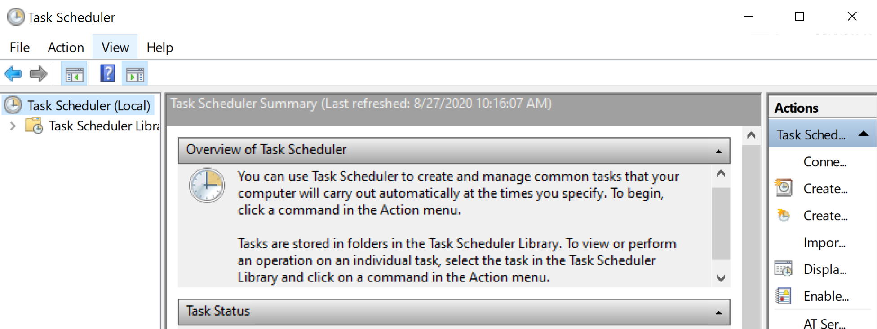
M2 – PII Collection: Data Breach Monitoring System
Step 3: The resulting XML will need to be preprocessed/cleaned
Check for relevance
Check for post date
Step 4: Once all RSS feed XML is returned, set up your script to run on a Windows Task Scheduler
Figure 17. Windows Task Scheduler

Slide 39
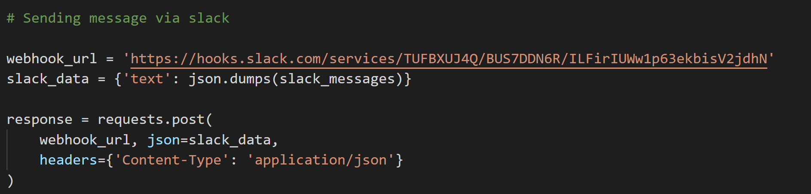
M2 – PII Collection: Data Breach Monitoring System
Step 5: Returned data is then sent to Slack
Slack provides webhooks for easy integration with their API
Figure 18. Code of Sending a Notification to Slack
Key drawback(s) of prior work: Omits timely discussion of data breach incidents from the hacker community
Planned Activity: Expanding data breach news sources to platforms in the dark web, e.g., ads in the promising hacker forum or Paste.

Slide 40
M2 – PII Collection: Surface Web and Deep Web
To extending PII collection from the dark web, we leverage two types of platforms:
Surface web: people search engines
These types of platforms are specifically designed to collect personal information from social media, public records, proprietary databases, etc.
Deep web: social media
Social Media provides rich image and location data of individuals.
Within each type of platform, we start with a brief overview of available information and then we give a tutorial for data collection.

Slide 41
M2 – PII Collection: Surface Web and Deep Web
Type of Platforms | Platform | Crawling Strategy | Input | Available Attributes
People Search Engine (Surface Web) | Spokeo | Access search results page through Google | Name + City + Public search service platform | Name, Age, City, Aliases, Gender, Locations, Aliases, Relatives
 | BeenVerified |  |  | Name, City, Age, Relatives, Phone Number, Job Title, Email, Addresses, Associated Names
 | MyLife |  |  | Name, Age, City, Associated Name, Job Title, High school, University, Address
 | That’s Them | Crawler | Full Name + Address Phone Email IP | Full Name, Gender, Age, Address, Zip Code, Phone Number, Email, Length of Residence, Household Size, IP Address, Estimated Net Worth, Estimated Income, Education, Occupation, Language
Social Media (Deep Web) | LinkedIn | Crawler | Email | Full Name, Photo, Education, Work, City, State
 | Twitter | API | Full Name | Username, Profile Name, ID, Description, Following Number, Follower Number, Photos
 | Instagram | API | Full Name | Username, Full Name, Follower Number, Following Number, Photo
Table 7. Summary of Surface Web and Deep Web Platforms

Slide 42
M2 – Surface Web: People Search Engines
Collecting data from people search engines using their provided search interface can be inefficient due to the long response time.
We develop a crawler that utilizes Google search to acquire the search result pages from these platforms.
Import Python packages: requests, fake_useragent, beautifulsoup, mysql-connector
We next detail the process of crawling.
We focus on the customized process for avoiding using search interfaces from people search engines (highlighted in red).
Note that we do not include code because it is similar to crawl data from hacker forums and carding shop.

Slide 43
M2 – Surface Web: People Search Engines
Process:
Step 1: Set the proxy configuration
Step 2: Initialize cookie, user-agents, and proxy
Step 3: Use the full name of the target user and the name of the people search engine (e.g., <Jingyu Xin MyLife>) as a query to search on Google
Step 4: Store the retrieved pages' URL with MyLife domain name on local
Step 5: Visit URLs stored locally
Step 6: Use the requests.get method to extract the attributes of interest
Step 7: Parse the extracted attribute values using beautifulsoup
Step 8: Store the data in MySQL database

Slide 44
M2 – Deep Web: Social Media Collection
We can leverage API to collect data from social media platforms.
APIs usually have a rate limit which limits the number of requests a crawler can send in a given time period.
Figure 19 shows the layout of an Instagram profile.
Next, we demonstrate the process of using Instagram the API to collect data.
Figure 19. Sample Instagram Profile Crawled from BuySSN Senior Subset

Slide 45
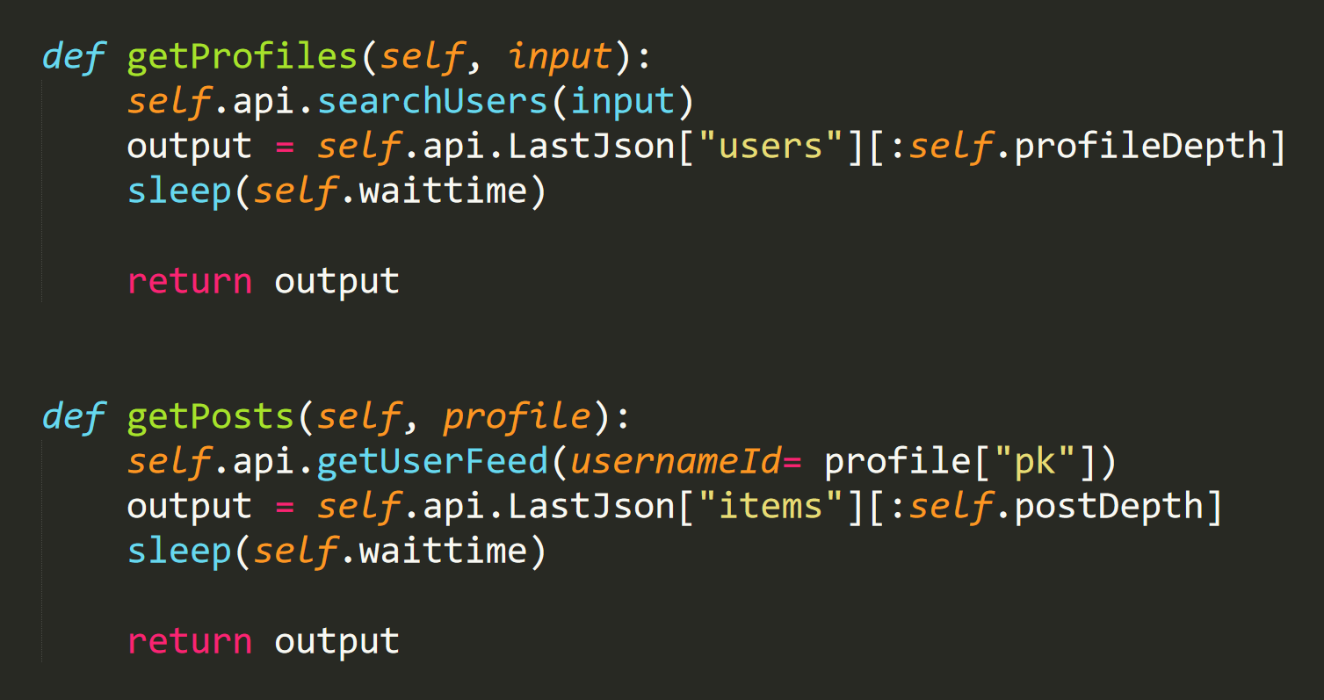
M2 – Deep Web: Social Media Collection (Instagram)
Step 1: Utilize appropriate API method
Step 2: Select data that are of interest
Step 3: Wait for a certain amount of time.
This keeps the crawler under the API rate limit
Step 4: Return output
Figure 20. Python Sample for Using Instagram API to Collect Profile and Post Data.

Slide 46
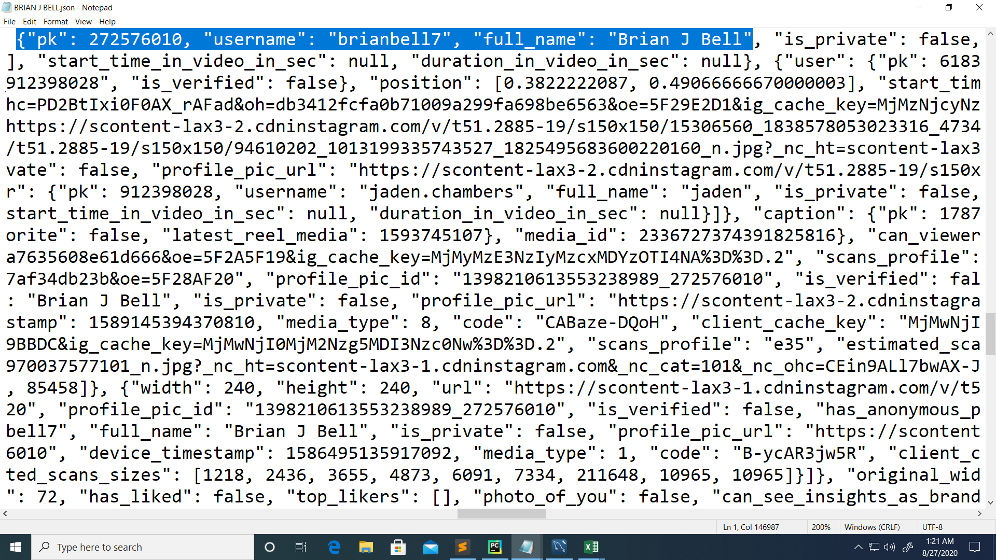
M2 – Deep Web: Social Media Collection (Instagram)
Figure 21 shows the post-crawling data parsing process
(b)
Save to Local
Save to Database
(a)
Figure 21. (a) Raw JSON Data. (b) Parsed Data Saved to CSV File. (b) Parsed Data Stored on SQL Server.
(c)

Slide 47
M2 –Entity Resolution
Entity Resolution (ER) is necessary to identify corresponding individuals on heterogeneous platforms given the incomplete and inaccurate PII obtained from the dark web, surface web, and deep web platforms.
Facilitates downstream analytics, e.g., privacy risk assessment
Name | Platform | YOB | City | State | Zip | Country
ADDIE JONES | BuySSN | 1949 | VERONA | PA | 15147 | USA
Match | Platform | Name | Age | Email | Address | Relatives | Phone
O | BeenVerified | Addie Shelton Jones | 70 | None | 132 Lisa Dr, Verona, PA 1551 Montier St, Pittsburgh, PA 108 Angela Dr, Pittsburgh, PA | Ella F Shelton Adelaide P Jones Raymond J Bey | 412***709
X | BeenVerified | Addie S Jones | 87 | baby****@aol.com jones_******@yahoo.com | 6242 N Park Ave, Philadelphia, PA 104 Hamlin Dr, Fredericksburg, VA 5242 N Park Ave, Philadelphia, PA | Lauren Casey Osiris Jones Connie E Jones | 215***495
X | BeenVerified | Addie P Jones | 119 | None | 1615 Benson St, Philadelphia, PA 2120 Afton St, Philadelphia, PA | None | None
Figure 12. An Example of Entity Resolution. The phone numbers are hided for privacy concerns.

Slide 48
M2 –Entity Resolution
Prior work: Leveraged deep learning-based entity resolution technique ()MCA to link text-based PII from the dark web to the surface web for assessing victims’ extent of PII exposure
Key drawback(s): Omit privacy risk caused by exposed non-text-based PII
Planned Activity: expanding assessing the types of exposed PII that leads to increasing privacy risk, including photos and location data
Multi-Context Attention (MCA) Model
Representation Generation
Record (Dark Web)
Binary Classification
Match or Unmatch
Figure 23. Abstract Operation of MCA
Representation Generation
Record (Surface Web)

Slide 49
M2 –Privacy Risk Assessment
We demonstrate how ER can help enhance privacy risk assessment.
Through matching records across the dark web and surface web, we can calculate individual’s privacy risk score.
For each individual, overall privacy risk score is calculated by summing up the scores of exposed attributes across the dark web and the surface web.
PII Attribute | Sensitivity Score ($β$)
Contact Number | 0.6
E-mail | 0.1833
Address | 0.85
Birthdate | 0.1166
Hometown | 0.15
Current Town | 0.1166
Job Details | 0.2
Relationship Status | 0.4166
Interests | 0.3
Religious Views | 0.5666
Political Views | 0.6833
Table 8. Sensitivity Score for 11 PII attributes (adopted from Srivastava et al.)
Notes:
As noted in our review of privacy risk assessment measures, the Sensitivity Score developed by Srivastava et al. [10] is suitable for privacy risk assessment in the dark web and surface web. Accordingly, we adopt Sensitivity Scores of 11 PII attributes developed in [10] and calculate the privacy risk score for each individual. These sensitivity scores are shown in Table I.

Slide 50
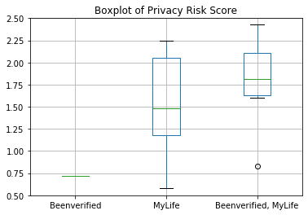
M2 –Privacy Risk Assessment
We average individuals’ privacy risk score for each people search engine to examine the privacy risk of each platform.
y-axis: privacy risk score
x-axis: platform
Black bars: minimum and maximum of privacy risk score for each platform
Green bars show the average privacy risk scores
The privacy risk of those victims exposed data in MyLife was significantly higher than the risk for victims whose data was exposed on Been Verified.
Figure 24. Boxplot of Privacy Risk Score across Two Surface Web Platforms.

Slide 51
M2 – PII Portal Design and Planning
Objective: Developing a PII portal which helps at-risk populations in providing a free service and educational resources to protect their PII.
Target users: Any internet users who are interested in the extent of their PII exposure across the dark web, surface web, and deep web.
Prior work: limited types of search seeds, lack of in-depth at-risk population analysis
Next, we propose our PII portal to address the limitation in the prior work.

Slide 52
M2 – PII Portal Design
Figure 25. Proposed PII Portal
Next, we present the proposed PII portal interface.

Slide 53
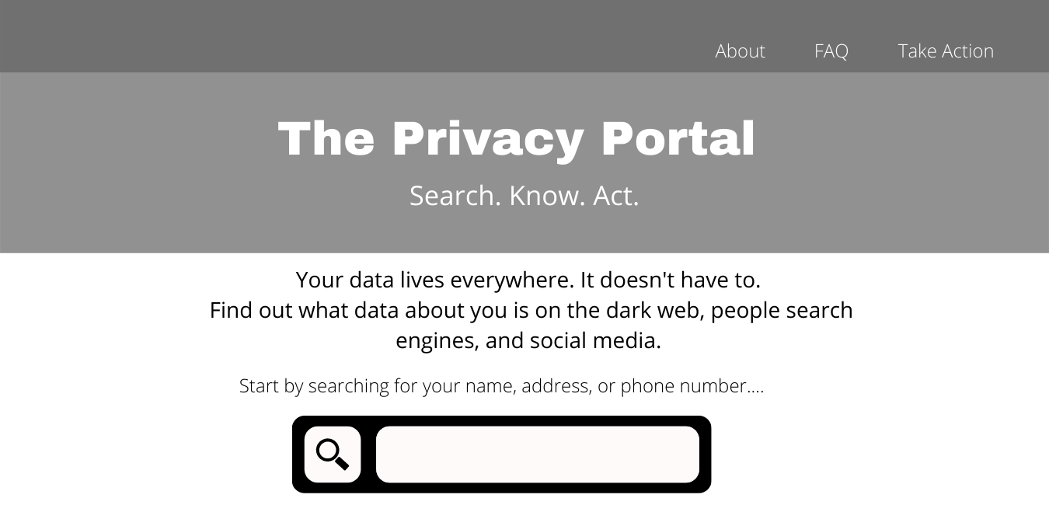
Figure 24: Sample Home Page
Search by name, address, phone number, etc.

Slide 54
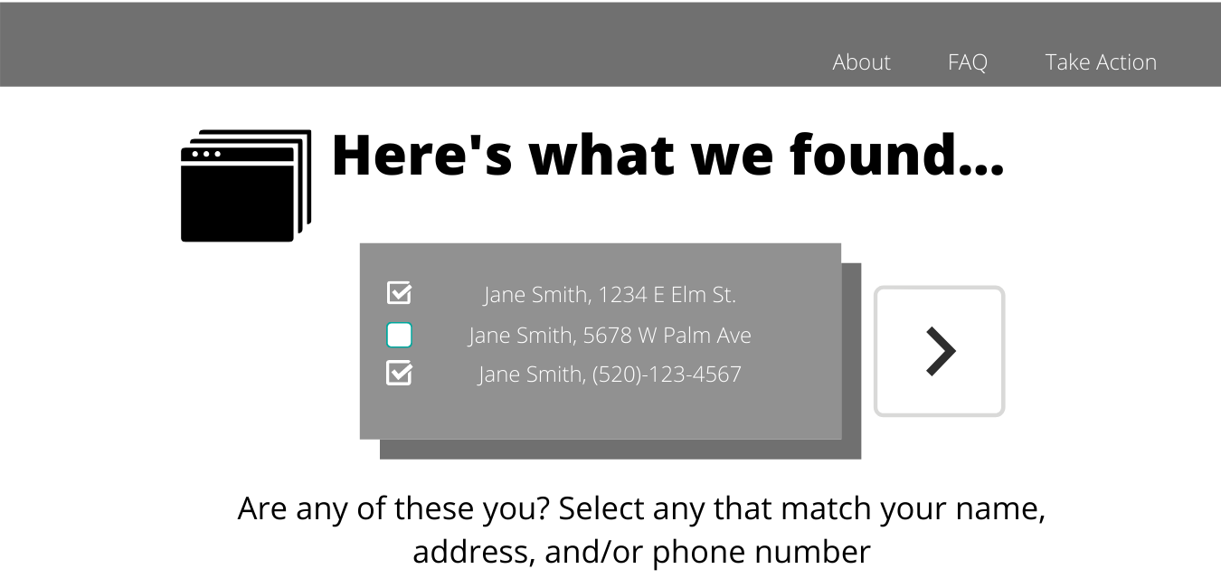
Figure 25: Query confirmation
Additional details act as confirmation that the user is who they say they are. Erroneous entries may be provided to prevent abuse of the system.

Slide 55
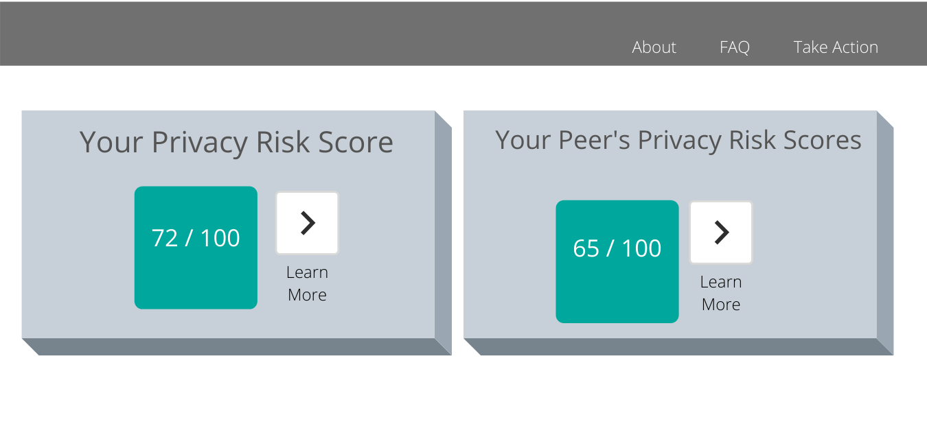
Figure 26: Privacy Risk Score Page
Individual’s privacy risk score
Demographic’s privacy risk score
Learn more button takes user to details page

Slide 56
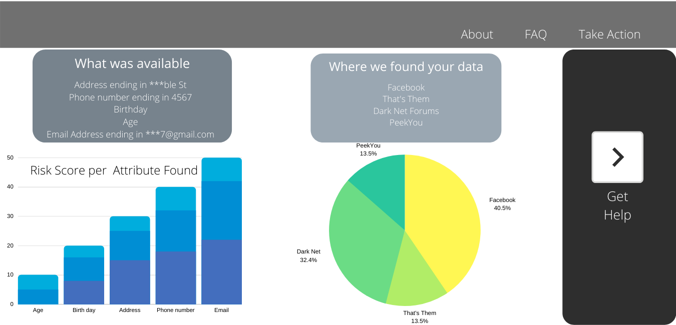
Figure 27: Details Page
Sources of data are generalized to preserve privacy
Data is partially masked to preserve privacy

Slide 57
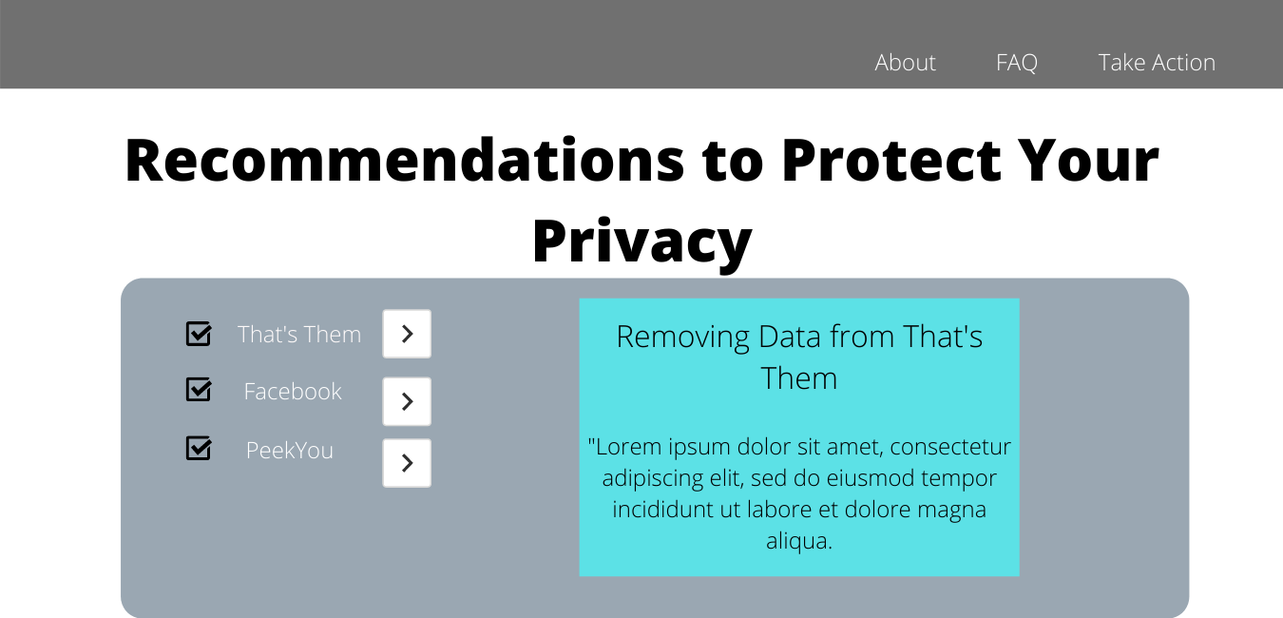
Figure 28: Individualized Recommendations
Individualized recommendations for protecting privacy based on the source of the user’s exposed data.

Slide 58
M2 – PII Portal Design and Planning: Required Skills
Key Feature | Stack Layer | Core Technologies | Required Competencies
Data Collection |  | Python, Scrapy, Beautiful Soup | Scripting, scraping, parsing
System Analytics |  | Pytorch, SciPy, Pandas, Scikit Learn, NumPy | Deep Learning and Machine Learning Methods
Core Functionalities, Visualization, Reporting | Data Management | MySQL, MongoDB | DB management & administration, query optimization, indexing
 | Backend | Python | Django, API integrations
 | Front End and Visualization | HTML, CSS, JS/JSX, D3/Tableau | React, Bootstrap, web design, mobile optimization, data viz
 | Security | Monitoring, testing | MySQL view and table-level controls, Cloudflare, API rate limiting, XSS and SQL injection testing, full stack access controls
 | Systems Administration | PowerShell, task scheduling, monitoring, notification | Virtualization, IIS, intrusion detection
 | Cloud Administration | Website hosting | Azure/AWS/Google Cloud, domain registry, load balancing, logging, cloud security
 | Ongoing Support | Optimization, Refactoring
Table 9. Summary of Required Competencies for each Feature

